Slide 1

Graduate Admissions Insights
By: Sandeep, Jayathi, Patra, Thao, and Uyen
Notes:
Thank you for joining us today. My name is Sandeep and We’re a team of five, and over the next 20 minutes we’ll take you through each stage of our graduate admissions funnel—from the very first inquiry all the way to final registration.
Our goal is to pinpoint exactly where students drop off, and which factors drive them forward, and We want to know where to focus our efforts to get more students to enroll.

Slide 2
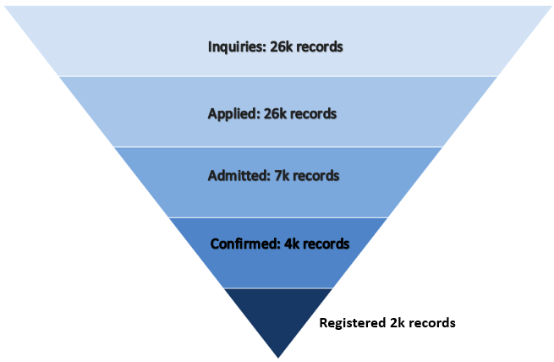
From Interest to Enrollment: The Funnel
Notes:
Let’s start by looking at our big picture here:Every year, thousands of prospective students express interest in Seattle University’s graduate programs. But somewhere along the way… most of them disappear.
So we asked: Where do they go? Why do they drop off? And—can we do anything about it?
Let’s take a look at the numbers. Over the last four years, We start with about 26 000 inquiries—and nearly every one of those goes on to start an application, which is fantastic. From there, just 7 000 of those applicants are admitted—that’s roughly one in four. We will know why did they not move forward shortly, but let’s stick to the numbers now.
Of those admitted students, 4 000 actually accept their offers, so we convert about 57 percent at that stage. Finally, only half of those who confirm—around 2 000 students—end up registering for classes.
That’s a huge drop-off — nearly 90% attrition from inquiry to enrollment.
What jumps out for me is where the biggest drop-offs happen: we lose more than two-thirds of applicants at the admission stage, and then half of our confirmed applicants at registration. That shows us exactly where to concentrate—making better admission offers, improving scholarship options, strengthening communication to constantly stay in touch with the applicant through out the process.
Every drop-off point in the admissions journey is a missed opportunity — not just for the university, but for the student who once expressed interest in joining our community.
That’s why our mission here is simple but critical: Can we identify who’s most likely to fall off — and why? And more importantly — can we predict it in advance?

Slide 3
How we approached it
Define funnel stage
Clean data
Apply statistical tests / predictive models
Generated insights
Notes:
“Here’s how we approached the problem:
On every stage, we followed the same four-step process. First, we defined what each funnel stage means and what counts for that stage. Next, we cleaned and prepared the data—standardizing dates, filling or dropping unnecessary values for every stage. Third, we ran the analysis—from simple correlations and statistical tests to complex ML models. And finally, we pulled out the insights and recommendations.
Keeping that funnel in mind will frame everything we discuss today. Next, me and jayathi dive into the early stages of the funnel: what makes an inquiry turn into an application, and who those stealth applicants are who skip the inquiry.’

Slide 4
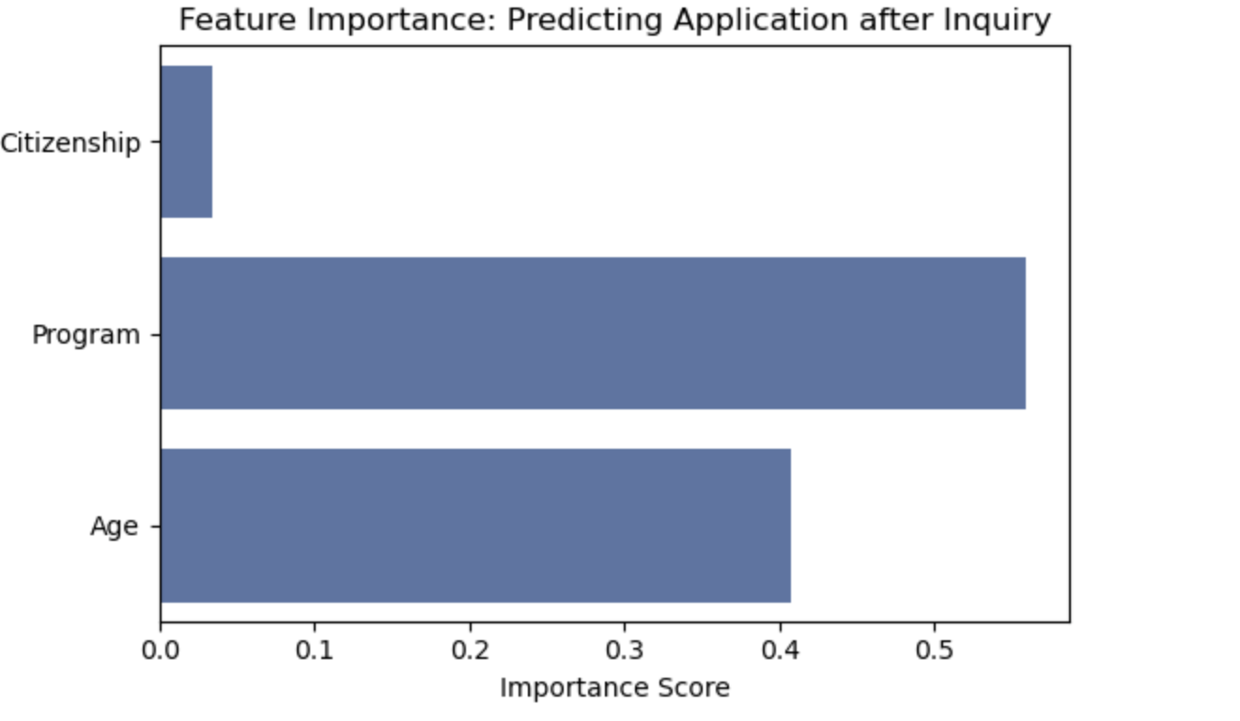
Inquiries / Stealth Applicants
Top Programs
Citizenship:
Age
Notes:
“Across both Step 1 (Inquiries→Applications) and Step 2 (Stealth Applicants), we ran a comprehensive feature‐selection exercise on a lot of candidate predictors. In every model iteration, these three things consistently mattered most
1. Program – which field a student inquires about
2. Age – their life‐stage at the time of inquiry
3. Citizenship – domestic versus international status
These three features not only delivered the highest predictive power but are also easy to address in our engagement efforts. So in the next slides, you’ll see exactly how much each one contributes to start an application.

Slide 5
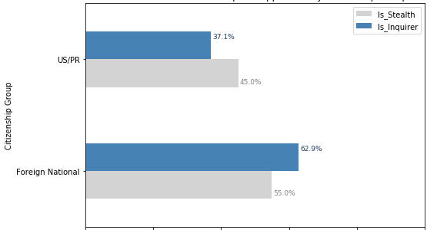
Notes:
International students are more likely to inquire when compared to domestic students before starting an application. This says that International students need more guidance and support with their application process whereas domestic students seem a bit more confident and aware of the process. That’s the reason why they are shown up as Stealth Applicants.

Slide 6
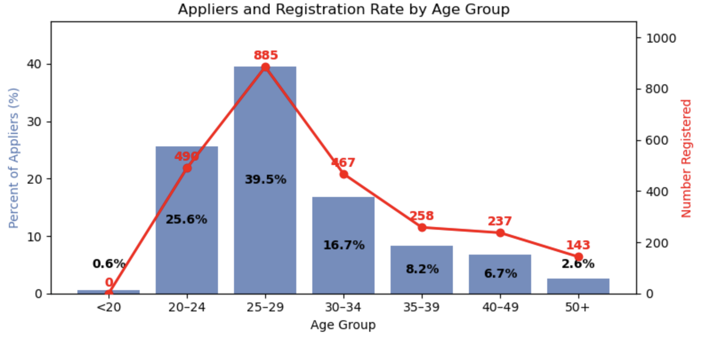
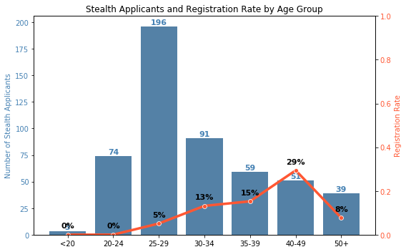
Younger Applicants
Inquire and Actually Register
Older Stealth Applicants
Registered (Younger Applicants Do Not)
Notes:
Applicants who inquire are more likely to register across all age groups. They have a very good registration rate. So providing support to Enquirers is not just helpful, but it’s a direct investment in enrollment success. Coming to the stealth applicants, Older applicants are more likely to register for classes. This shows their commitment, clear goals in mind to get back to college and study. Younger applicants may have different career options and they are not ready to commit.

Slide 7
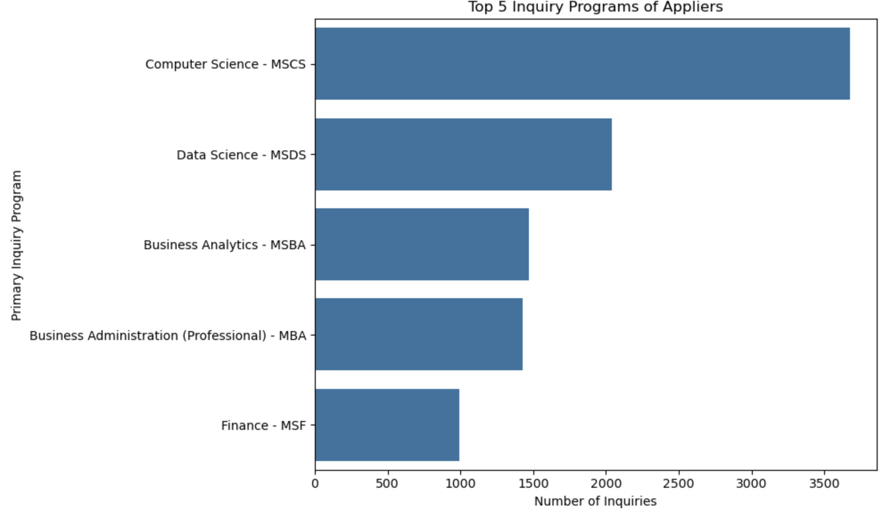

Slide 8
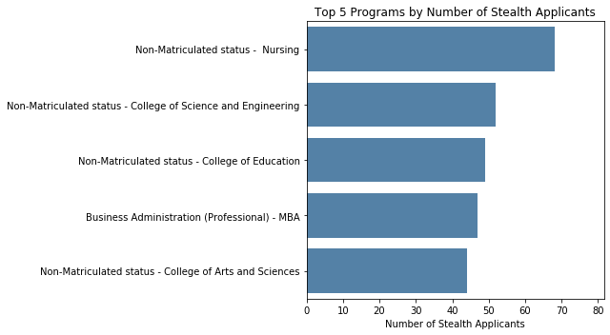

Slide 9
Notes:
As we move through the funnel, we can see a significant leak between the 'Applied' and 'Admitted' stages. The number drops drastically from 26k to 7k. While part of this drop is due to the university's admission decisions to admit or reject, a significant number of applicants also drop off during the processSo Let’s analyze the factors contributing to this.

Slide 10
Drop off applicants
1. Who Starts But Doesn’t Submit?
Key Factors:
College
Age Group
Race Group
Notes:
Now let’s analyze the drop-off applicants— first start with those who start but don’t submit their application.
we identified the top three factors that are: the college, the age group, and the race group

Slide 11
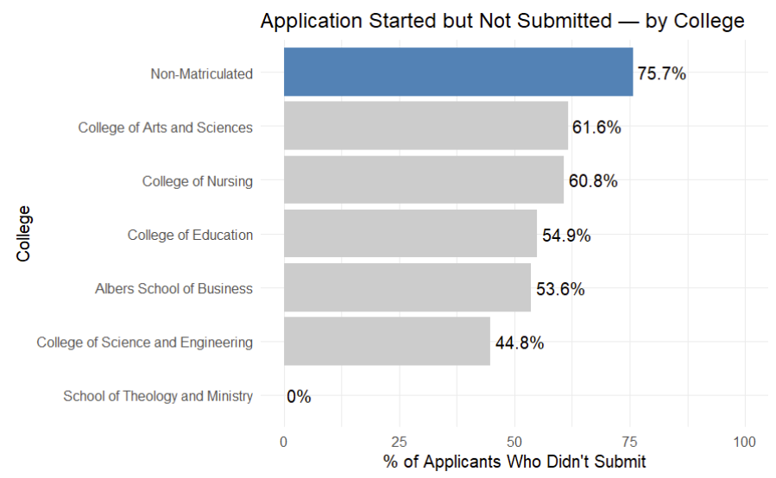
Who Starts But Doesn’t Submit? - By College
Stealth applicants in non-matriculated programs are the most likely to start an application but not follow through
Notes:
Let's begin with the college factor.
Here the chart shows that most of those who start but don’t submit their application are from non-matriculated, such as certificate programs, rather than degree programs.
Next this second chart, as this which Jaythi pointed out earlier, that stealth applicants often choose non-matriculated programs.
Together, these two points suggest that stealth applicants in non-matriculated programs are the most likely to drop off.
his could be because they didn’t inquire at the beginning and therefore have no one guiding them through the process, leaving them confused about the application steps.= Or, they may simply not feel fully committed, as they might only be interested in taking a class or two

Slide 12
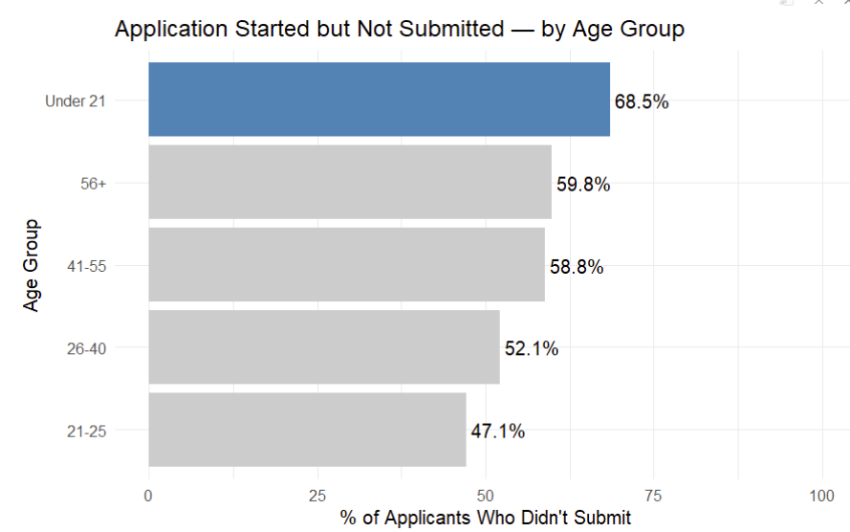
Who Starts But Doesn’t Submit? - By Age
Notes:
Next is age factor, We found that applicants under 21 had the highest drop-off rate, this actually makes sense, cause think about it, it’s unlikely they’d apply for grad school while still in undergrad. Some are just exploring without intending to apply, others may realize they don’t meet the requirements, and some could be test records or fake accounts. There’s also the possibility of errors, like entering the wrong birthdate.
Next, we saw a drop-off among older applicants, particularly those aged 41-55 and 56+. This is understandable as these groups often have jobs and families, which can make completing the application difficult. Some may consider grad school for a career change or personal goal but later question if it’s the right fit. Others might explore without fully committing or feel overwhelmed by the online application and document requirements, especially if they haven’t been to school in years.

Slide 13
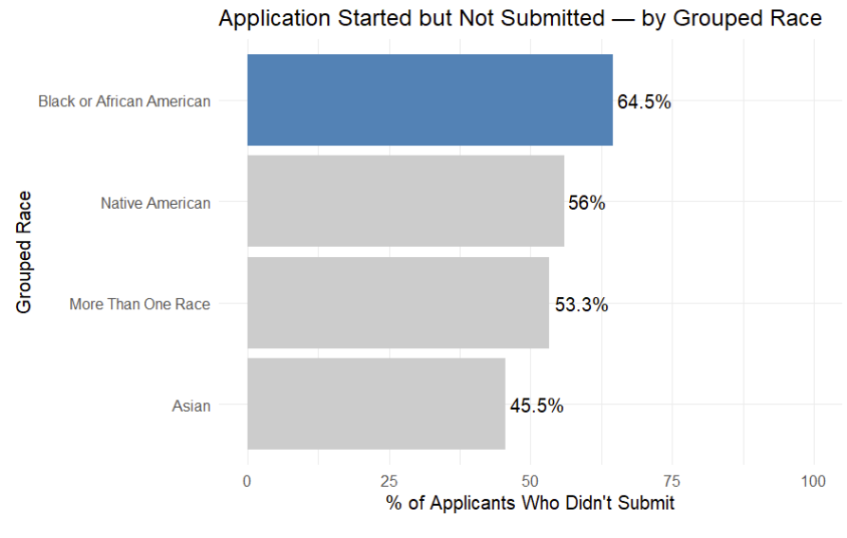
Who Starts But Doesn’t Submit? - By Race
Notes:
Looking at the graph, we see that Black or African American applicants are more likely to start an application but not submit it. We don't have the full explanation for this yet, and more data is needed to better understand this trend. But, this is definitely something worth to explore further."

Slide 14
Drop off applicants
2. Who Submit But Doesn’t Complete?
Key Factors:
College
Primary Inquiry
Application Term
Notes:
We’re looking at a different kind of drop-off — applicants who submit their application, but don’t finish all the requirements.
From our analysis, the top three factors linked to this group
College, Primary Inquiry, and Application Term

Slide 15
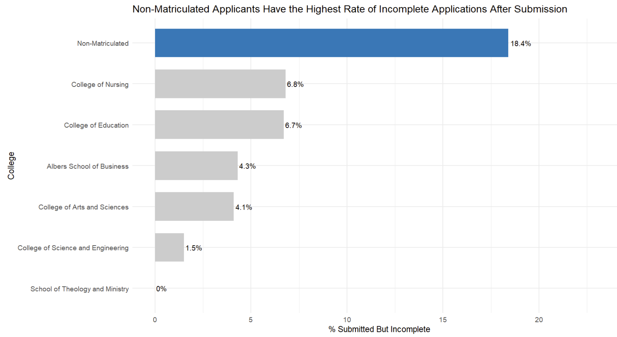
Who Submit But Doesn’t Complete? - By College
Notes:
"Again, non-matriculated applicants stand out in submit but don’t complete
This maybe They may not understand what’s required after submission.
They might not get the same follow-up as degree-seeking applicants.
Or Many of them are stealth applicants, that they woek on the application process on their own.
This confirms that non-matriculated applicants are more likely to drop out of the process

Slide 16
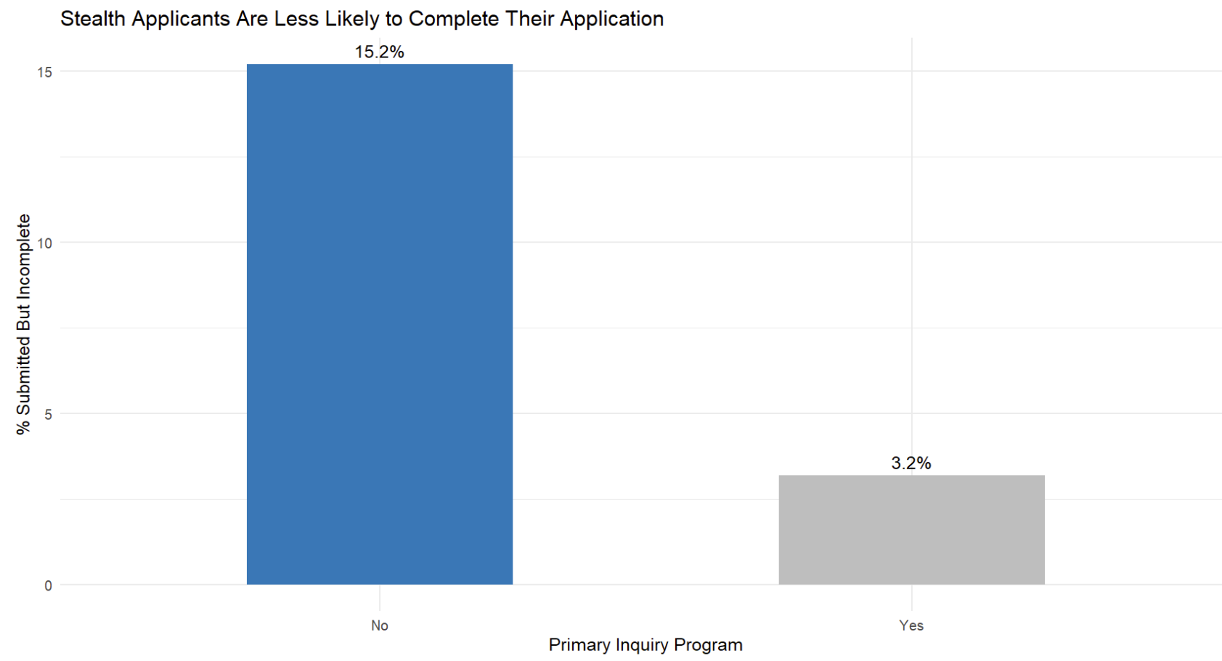
Who Submit But Doesn’t Complete? - By Inquiry
Notes:
This chart shows a big difference in completion rates based on whether students inquired before applying. The blue bar represents those who didn’t inquire first, and they have a higher rate of starting but not finishing the application. Possible reasons for this include:
They might not realize they still need documents like transcripts or recommendations.They’re less engaged compared to those who inquire.They don’t receive follow-up reminders like inquiring applicants do.Some may just be exploring the process without the intention to complete it.

Slide 17
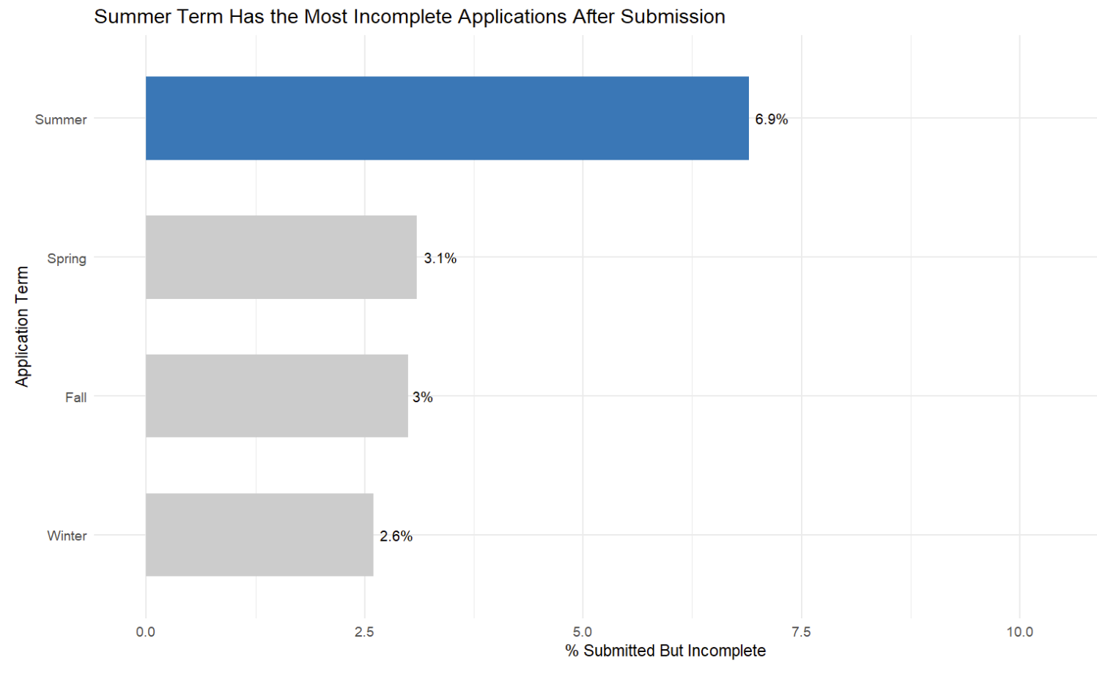
Who Submit But Doesn’t Complete? - By Application term
Notes:
When we look at the application term, we see a higher drop-off rate among summer applicants. This could be because:
Summer applicants are often just looking for a single course or certificate, so they might not be as committed to finishing the application.
Many people take vacations or have other commitments in the summer, which can get in the way of completing the process.

Slide 18
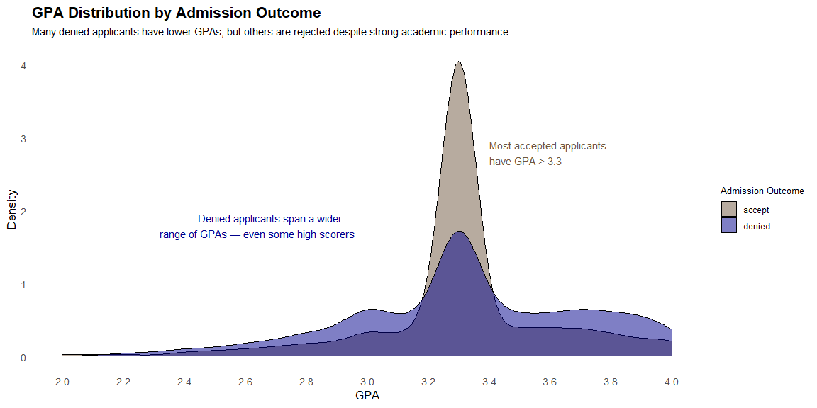
What Factors Are Associated with Graduate Denial?
“Applicants Aged 45+ Have the Highest Denial Rate Across Age Groups” – 23.5%
“Domestic Applicants Are Denied More Often Than International Students” - 29.2%
Notes:
Now, let’s shift our perspective. Up until now, we’ve focused on the applicants' view—but what does the Seattle University perspective reveal? Who is most likely to be denied, and why?
It’s easy to assume that GPA is the deciding factor. However, the data tells a more nuanced story.
Take a look at this graph: Accepted students mostly cluster between a 3.2 and 3.6 GPA, but here’s the surprising part—denied applicants span a wide GPA range, from 2.0 all the way up to 4.0. That means even high-performing students with strong academics are being denied
This show clearly that: GPA alone doesn’t explain admission outcomes. We need to look deeper.
Understanding these patterns is crucial for leadership—not just to know who applies, but to predict who is likely to enroll or be denied

Slide 19
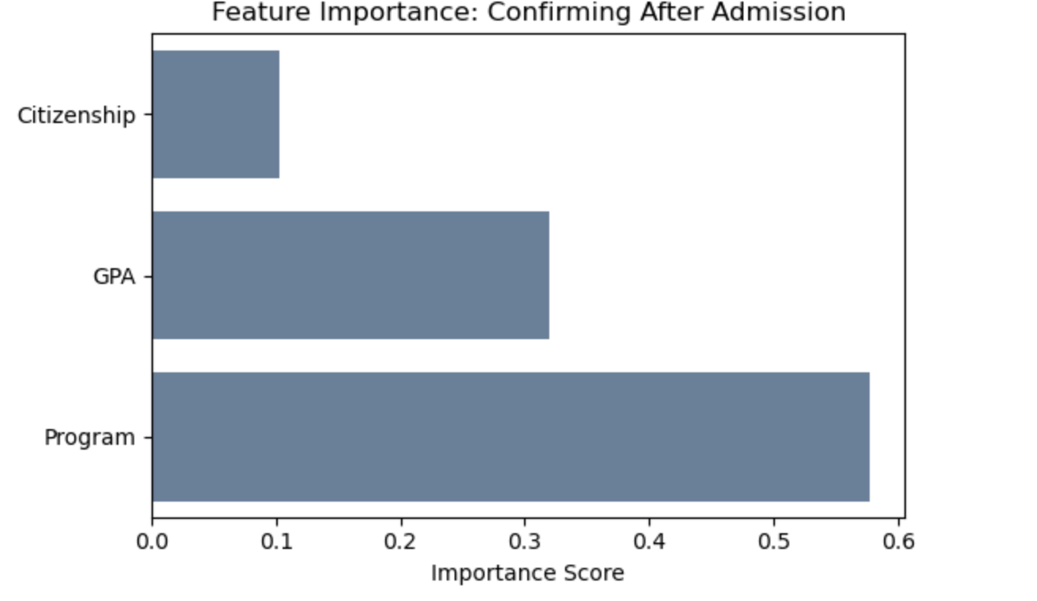
Understanding Applicants who get admitted but don't confirm
Higher non-confirmation rates among international students.
Non-confirmation spikes for GPAs below 3.2.
Programs like MSCS, MSDS, and MSBA lead in non-confirmations.
Younger applicants (early 20s) show higher non-confirmation rates.
Visuals Link

Slide 20
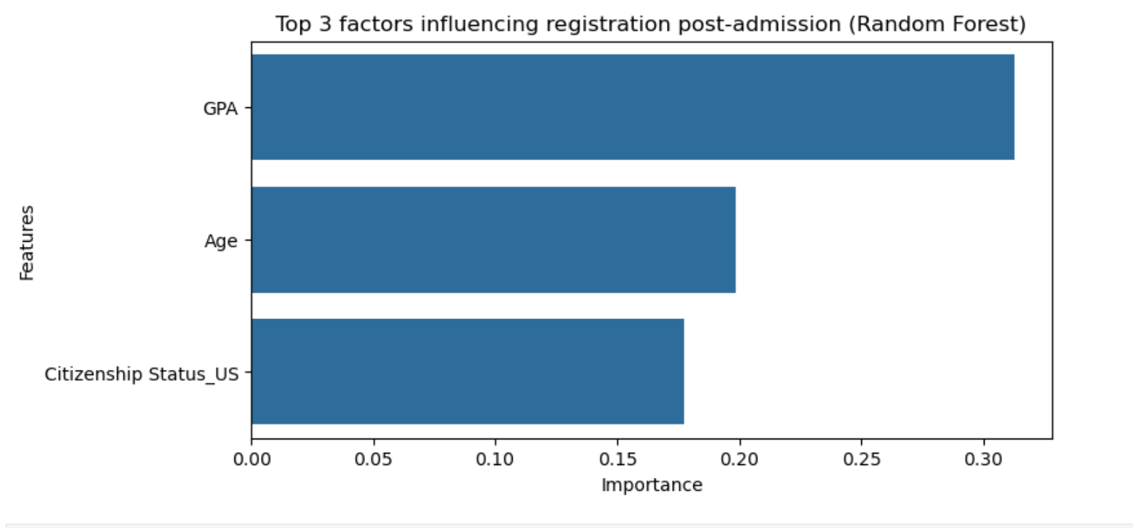
Who Doesn’t Register After Confirming?
GPA: 72.7% of applicants with GPAs between 3.0 and 4.0 did not register.
Age: 66.3% of non-registrants are aged 22–30.
Citizenship: 83.7% of non-registrants are foreign nationals.
Visuals link

Slide 21
Recommendations
Provide personalized support and guidance at every stage, from inquiry to registration.
Actively reach out to applicants who do not confirm or register to understand their challenges and offer tailored solutions.
Assist with exploring alternate programs or deferral options to keep applicants engaged.
Enhance communication about scholarship opportunities and application guidance to address financial concerns.
Focus on proactive engagement to ensure applicants feel supported throughout the enrollment journey

Slide 22
Hypothesis: There is identifiable data that can predict someone enrolling in graduate school at SU
➔ Yes
Outcome-focused
with stage-specific analysis.
Model
(Random Forest, XGBoost)
Metric
(Accuracy, Precision, Recall, F1 Score, ROC AUC)
Notes:
“As we mentioned earlier, our approach was outcome-focused, but also stage-specific.
Rather than just predicting who enrolls, we broke down the entire funnel into key stages — who applies, who gets admitted, who confirms, and who ultimately registers.
To explore this, we used Random Forest, because the data is imbalance and Random Forest is well-suited to handle this — it works well with complex, non-linear data and performs reliably even when the classes are uneven.
But to directly answer our core hypothesis — Is there identifiable data that can predict whether someone will enroll in graduate school at Seattle University? — we used XGBoost.
Extreme Gradient Boosting, a highly accurate and scalable model often used in predictive analytics.
In imbalanced datasets like admissions, where the majority of applicants don’t enroll, the model tends to predict 'no' for everyone. The model may produce high accuracy, but it doesn't effectively predict actual applicant enroll. This is why relying on accuracy alone is misleading in this situations. so that we consider other metrics precision, recall, F1 score, and ROC AUC.

Slide 23
Technical Appendix

Slide 24
Models/Metrics
['College', 'Primary Inquiry Program', 'Application Program', 'Sex', 'Citizenship Status', 'Age Group', 'Application Term', 'Grouped Race', 'Scholarship Amount', 'Received Scholarship', 'Student Classification', 'GPA Group']
Model | Accuracy | Precision (1) | Recall (1) | F1 Score (1) | ROC AUC
Random Forest | 81.5% | 28.8% | 41.7% | 34.1% | 0.7616
RF + SMOTE | 78.6% | 27.9% | 54.9% | 37.1% | 0.7736
XGBoost | 81.6% | 29.9% | 68.1% | 41.6% | 0.8571
Logistic + SMOTE | 65.9% | 23.0% | 83.9% | 36.1% | 0.8006
XGBoost best balance — high accuracy, recall, F1, and ROC AUC.
Logistic + SMOTE maximum recall but sacrifices precision and accuracy.
Random Forest has high accuracy but misses many enrollees.
RF + SMOTE improves recall over baseline but still not as strong as XGBoost.
Notes:
In imbalanced datasets, like the one you have in predicting admissions (where only 10-15% of applicants actually enroll), accuracy becomes less meaningful and even misleading (So if a model just guesses "No" for everyone, it could be 90% accurate — and still be useless.)
Why the Other Metrics Matter More in Imbalanced Data:
🔍 What You Actually Care About:
Precision measures the accuracy of positive predictions.
Recall focuses on ensuring that you catch all the actual enrollees.
F1 Score balances precision and recall into a single score. (F1 Score is especially useful in imbalanced datasets, where you want a model that balances between catching as many real enrollees as possible and avoiding false predictions.)
The ROC AUC score tells you how well your model distinguishes between enrollees and non-enrollees across all possible thresholds.
It’s independent of the decision threshold (for example, the probability cutoff for predicting someone will enroll).
The higher the AUC, the better your model is at distinguishing the two classes, even if you don’t have a fixed decision rule in mind.
Why These Metrics Are Important in Admissions:
Imbalanced Data: In admissions, there are often far more non-enrollees than enrollees. Accuracy alone can be misleading because a model that predicts "no enrollment" for everyone could still be highly accurate but completely useless. These other metrics (precision, recall, F1 score, and ROC AUC) give you a better understanding of how well the model is identifying actual enrollees.
Precision: Helps ensure you are efficient in outreach, focusing on the students who are most likely to enroll. You don’t want to waste resources on students who won’t enroll.
Recall: Ensures you catch as many enrollees as possible, especially when missing an enrollee could mean lost opportunities.
F1 Score: Balances recall and precision, giving you a single metric to evaluate how well your model is performing when both false positives and false negatives matter.
ROC AUC: Helps you understand the overall ability of your model to separate enrollees from non-enrollees, regardless of the specific decision threshold, and provides an evaluation of the model's ability to rank students who will enroll higher than those who won’t.

Slide 25
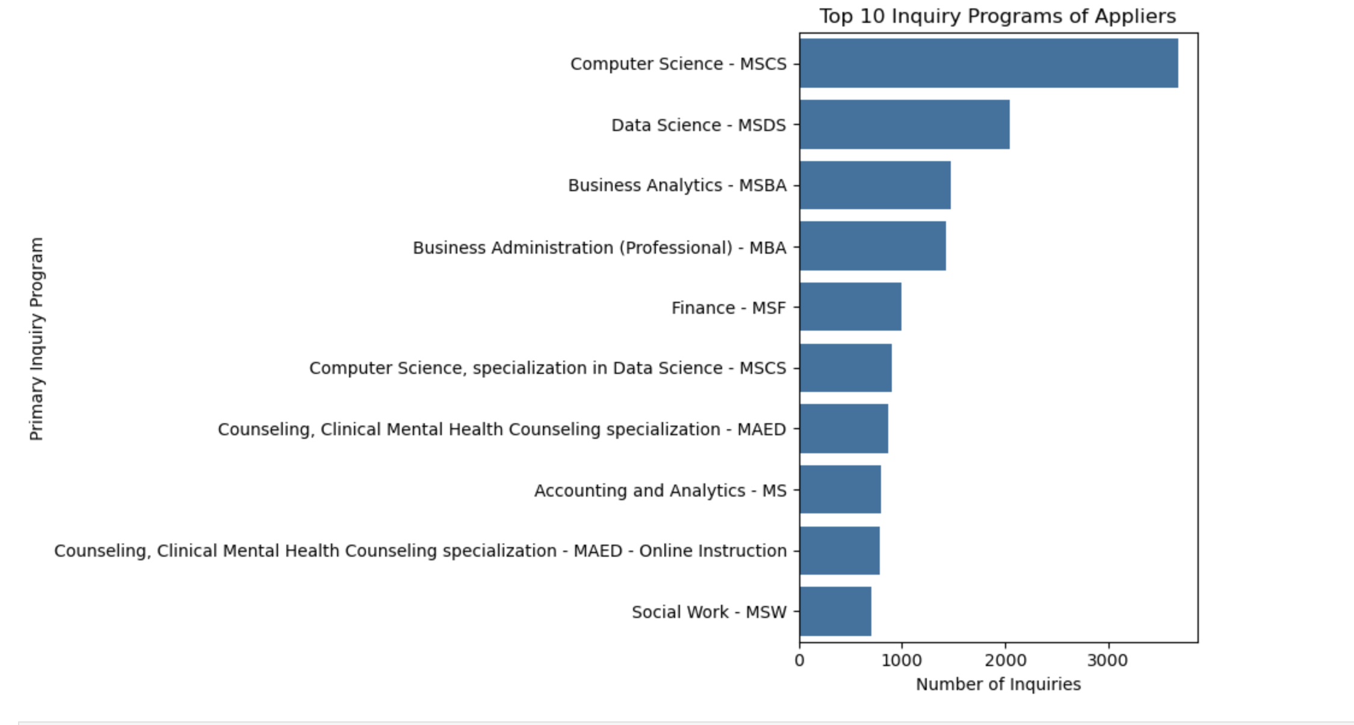
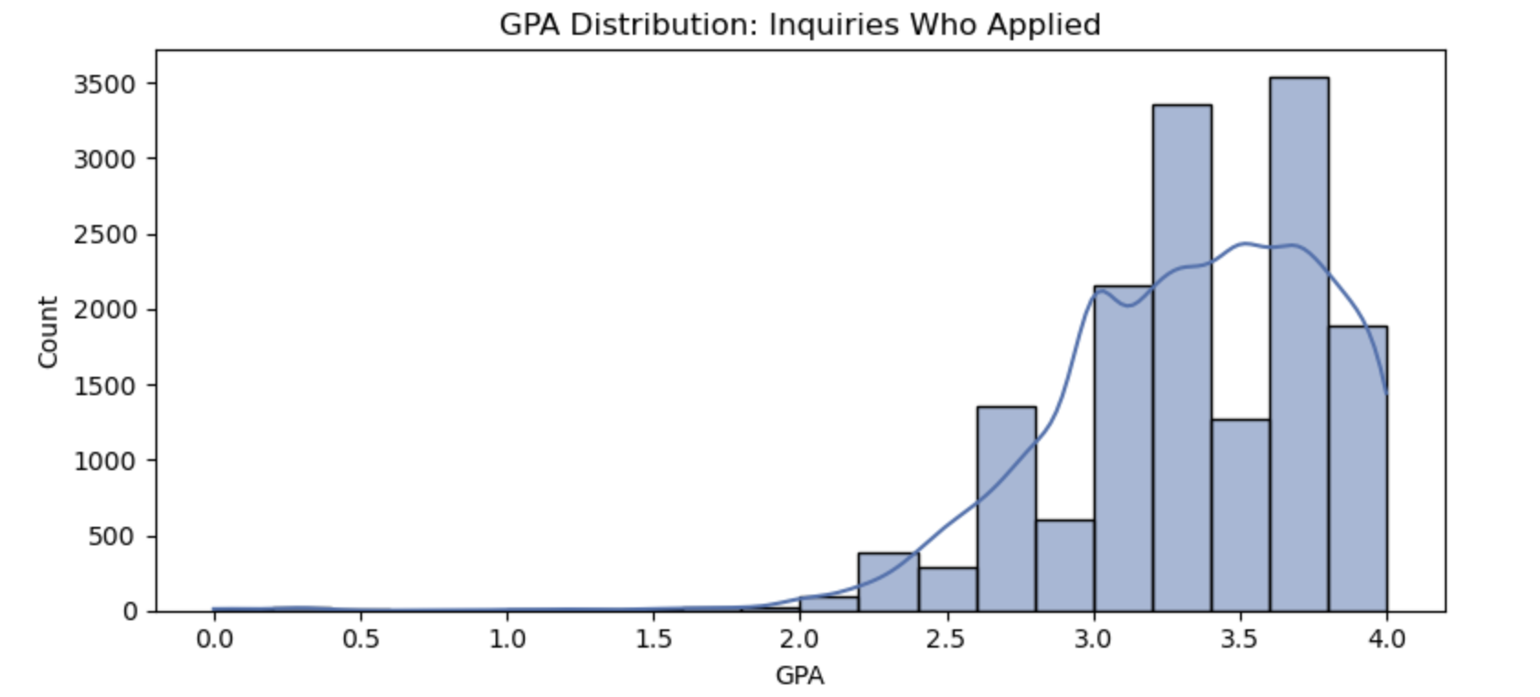
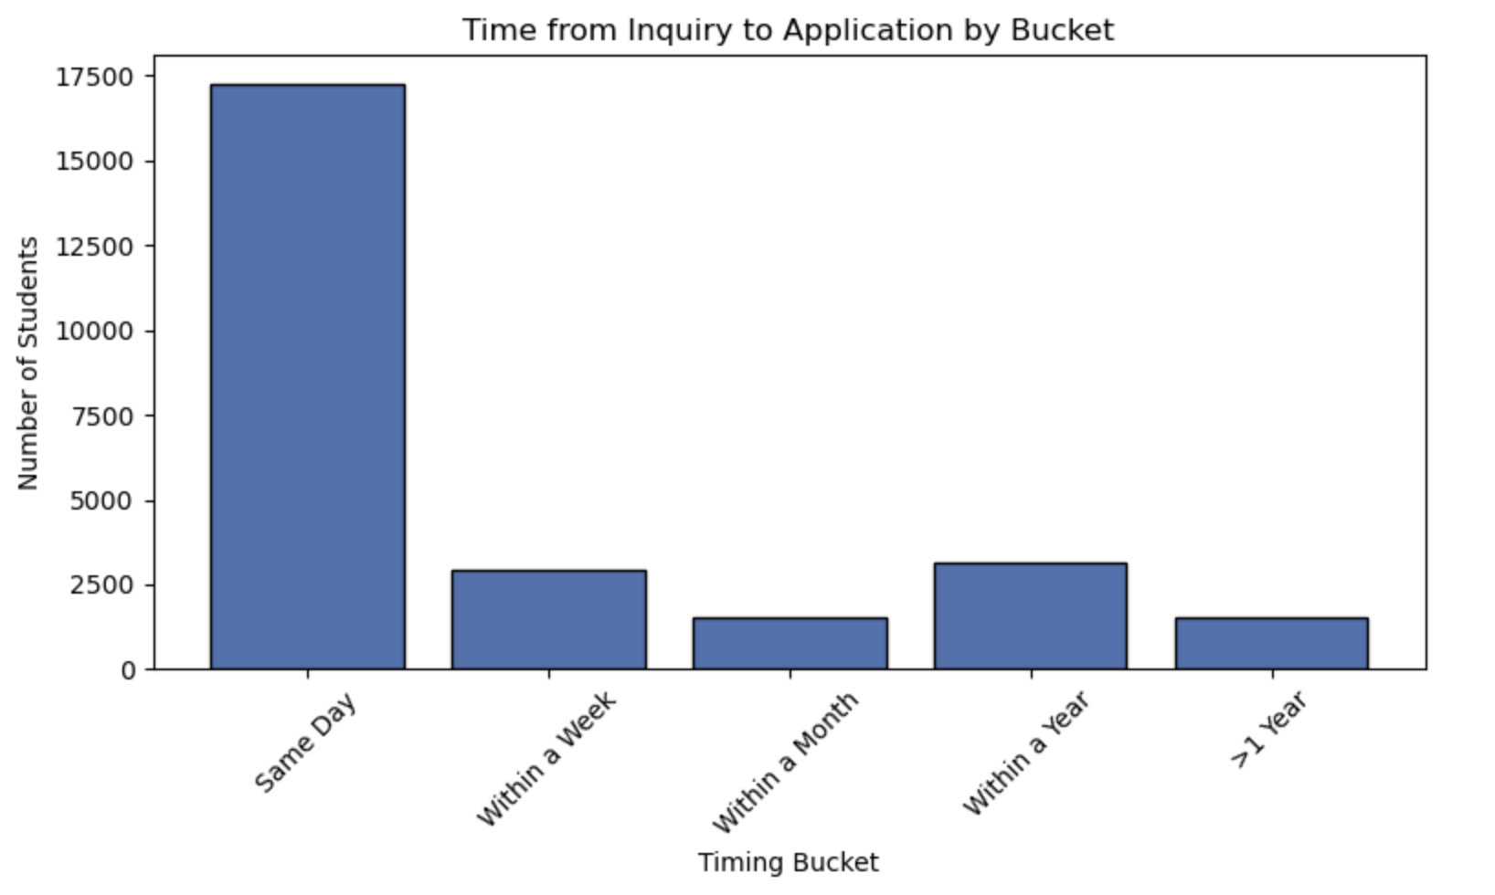
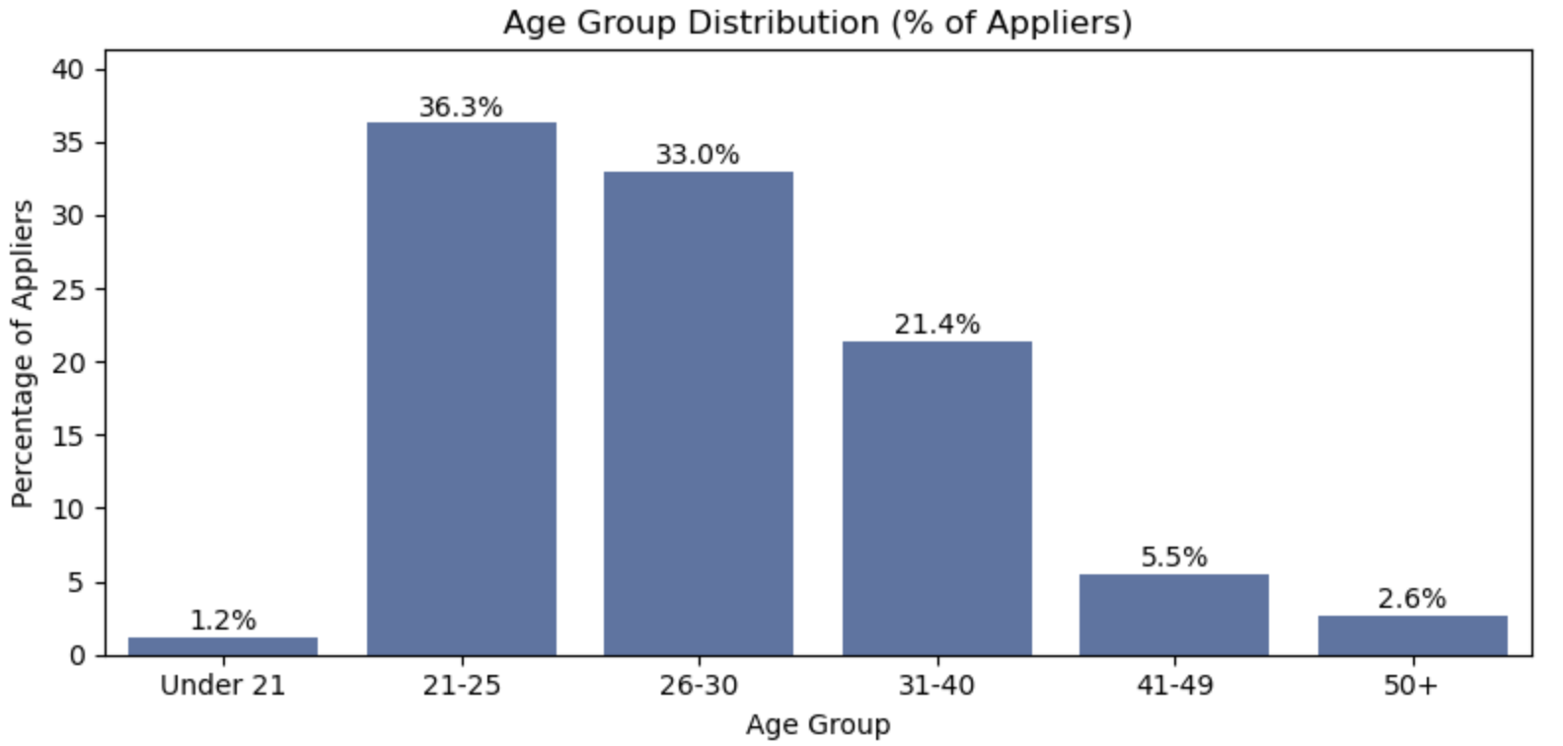

Slide 26
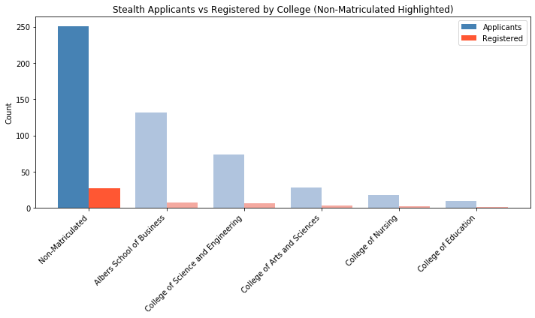

Slide 27
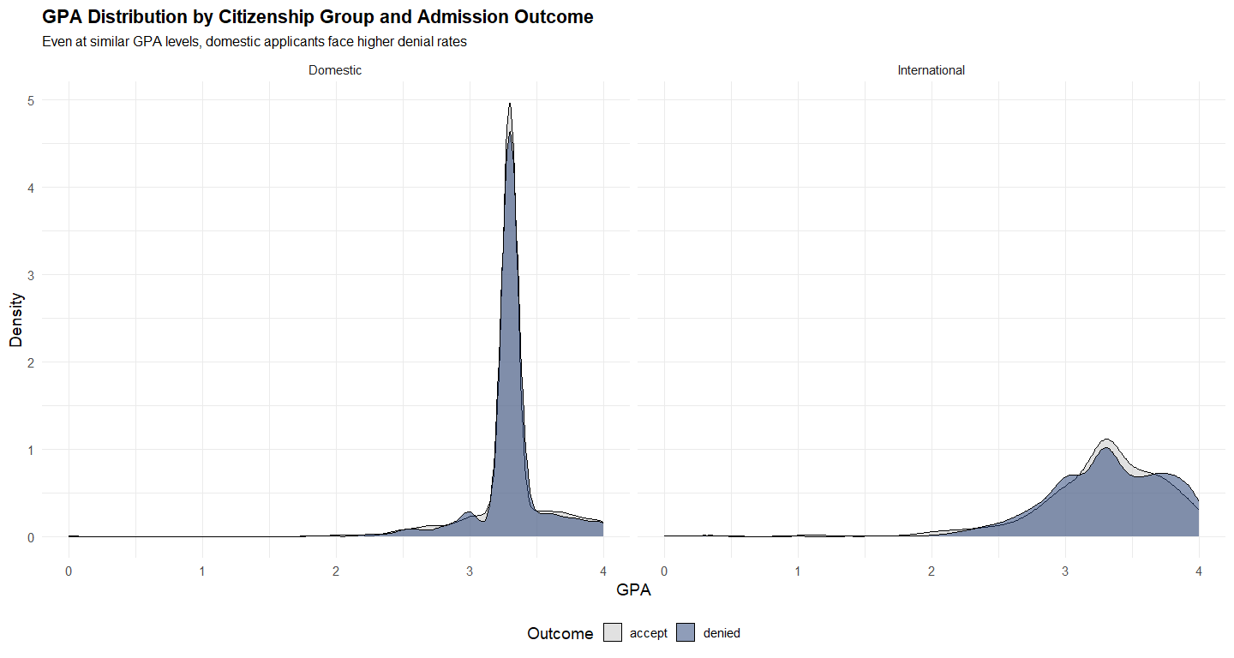
Why might domestic applicants be denied more?
Notes:
Now here’s an unexpected result.
When I grouped applicants into domestic vs. international, I found that domestic applicants face higher denial rates—even at the same GPA levels. At first glance, this raised concerns about equity.

Slide 28
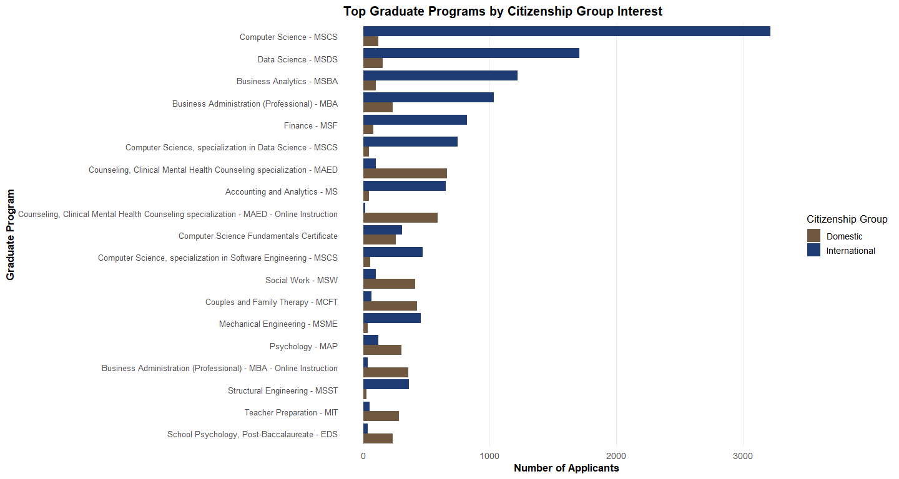
Domestic and International Applicants Show Different Program Preferences
BACK
Notes:
But deeper analysis provided context. International applicants predominantly apply to high-capacity programs like Computer Science, Data Science, and Business Analytics—fields with growing capacity. In contrast, domestic applicants often pursue clinically oriented programs like Social Work and Counseling, which have tighter accreditation standards and faculty supervision requirements.
So, it’s not necessarily a matter of bias. Instead, it's a matter of program capacity and regulatory constraints that shape these outcomes.

Slide 29
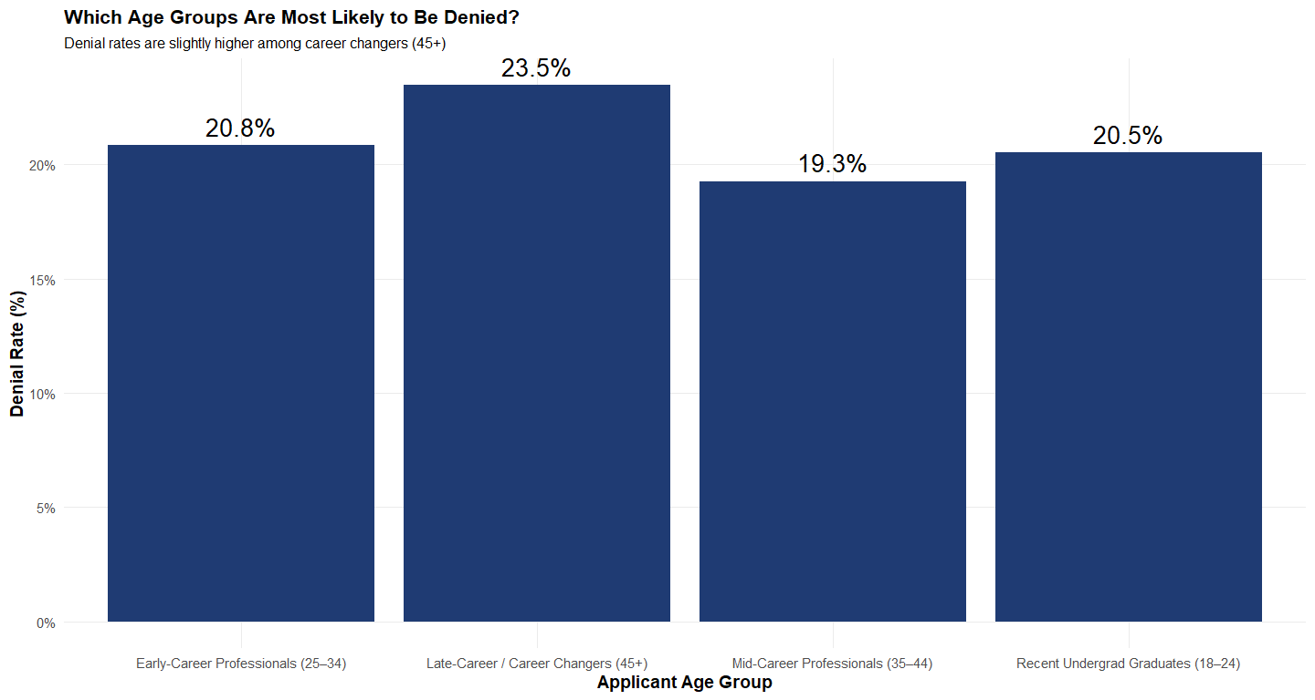
Notes:
I grouped applicants into four age categories. What stands out is this: denial rates increase dramatically for applicants over 45. This raises an important question—is Seattle University unintentionally favoring certain age groups?

Slide 30
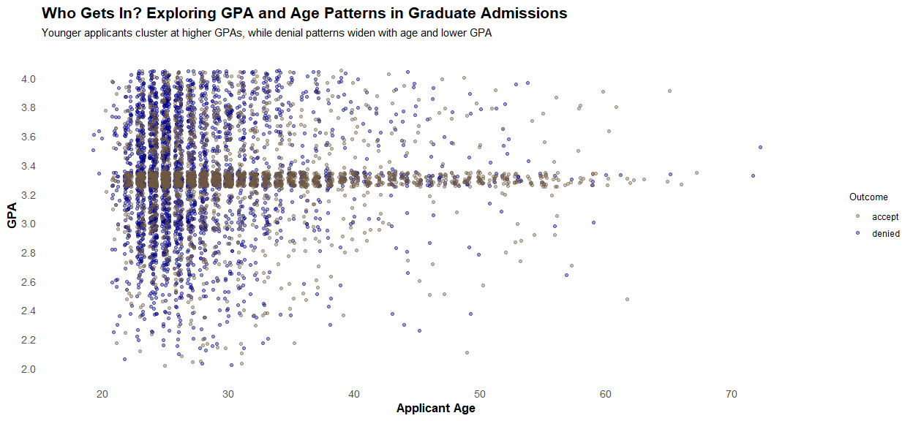
BACK
Notes:
To explore this further, I analyzed the interaction between age and GPA. Yes, older applicants tend to have lower GPAs, but even those with strong academic records face higher denial rates than their younger peers with similar GPAs. This suggests that non-academic factors may be influencing decisions—perhaps concerns about how well late-career applicants align with program goals or transition timelines.

Slide 31
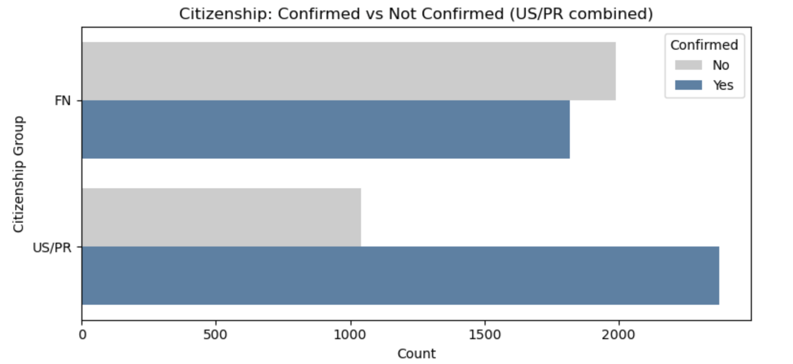
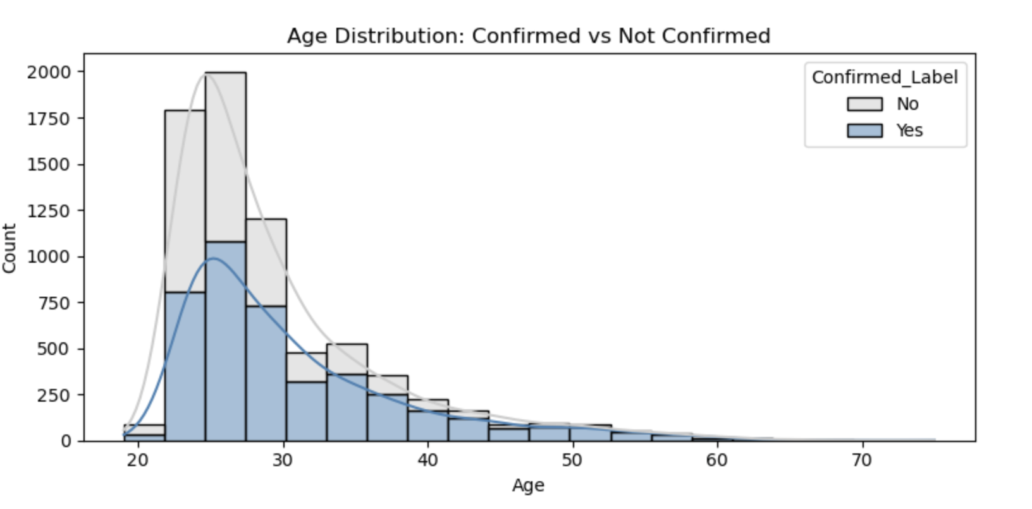
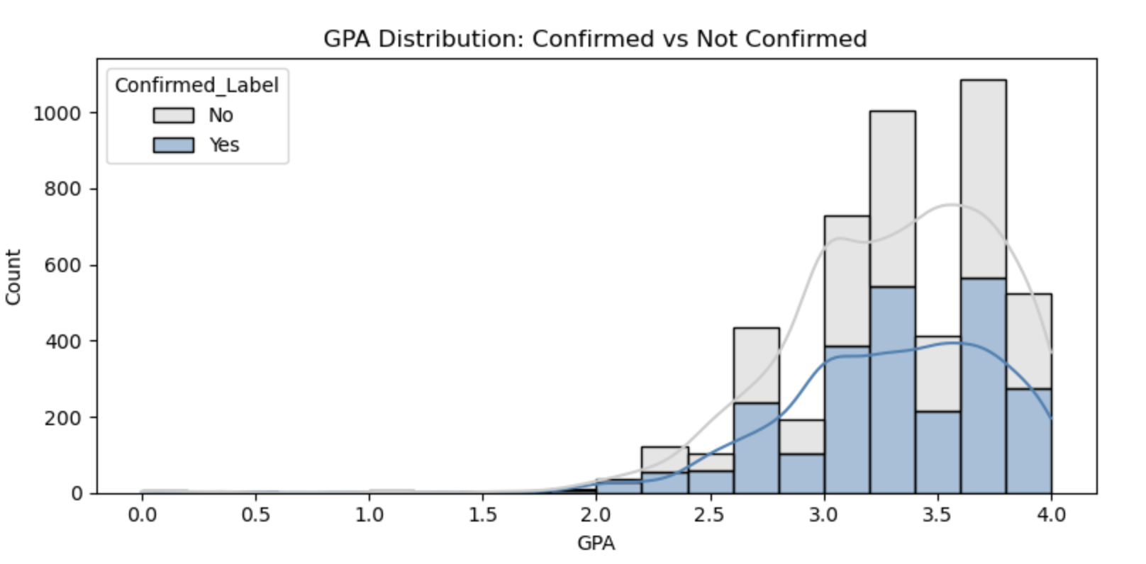
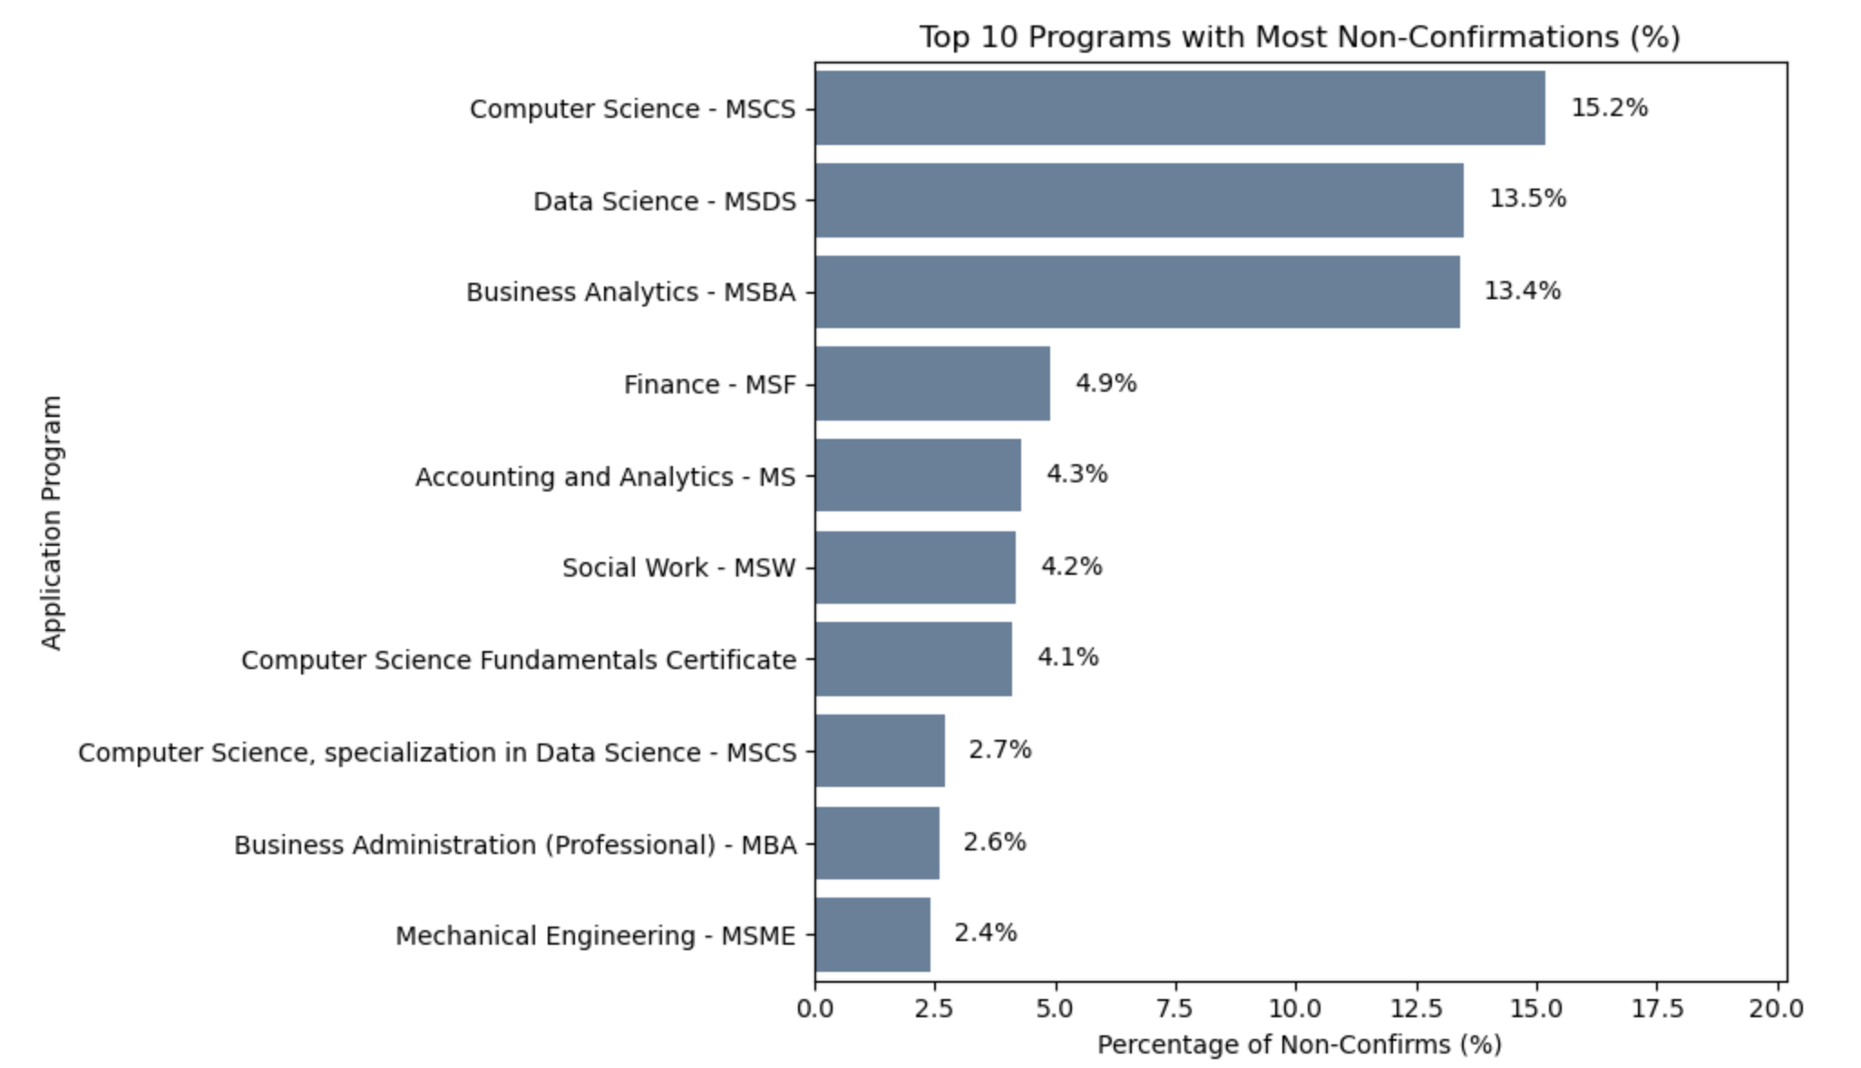
BACK

Slide 32
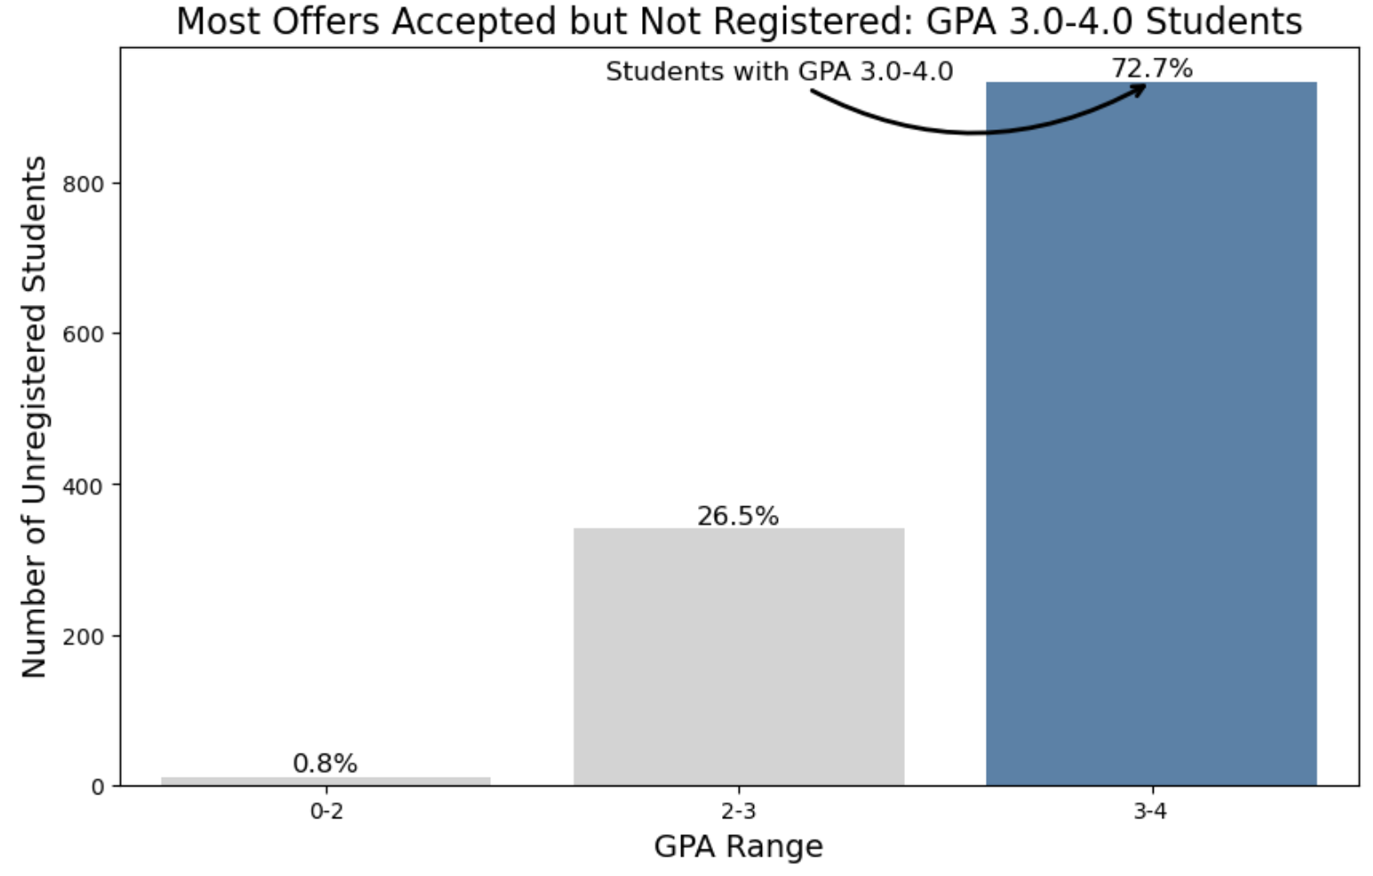
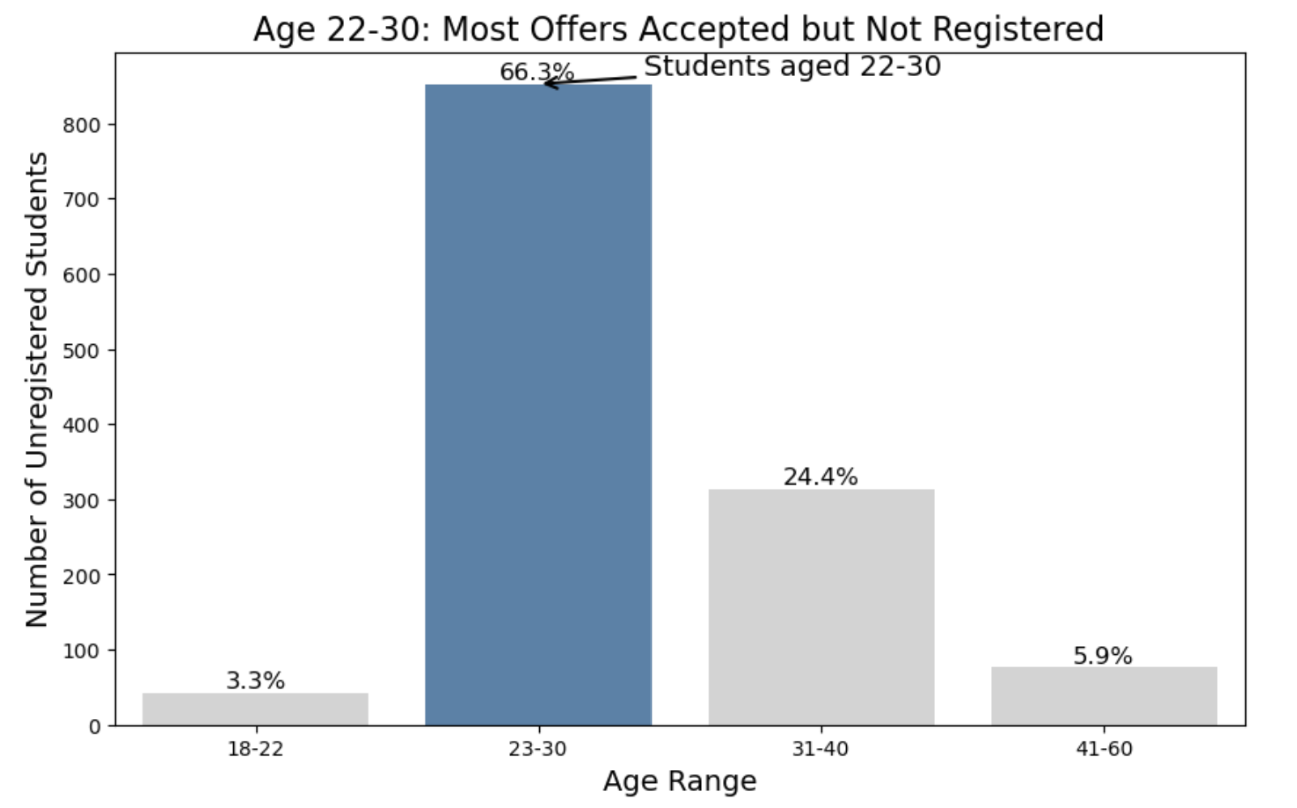
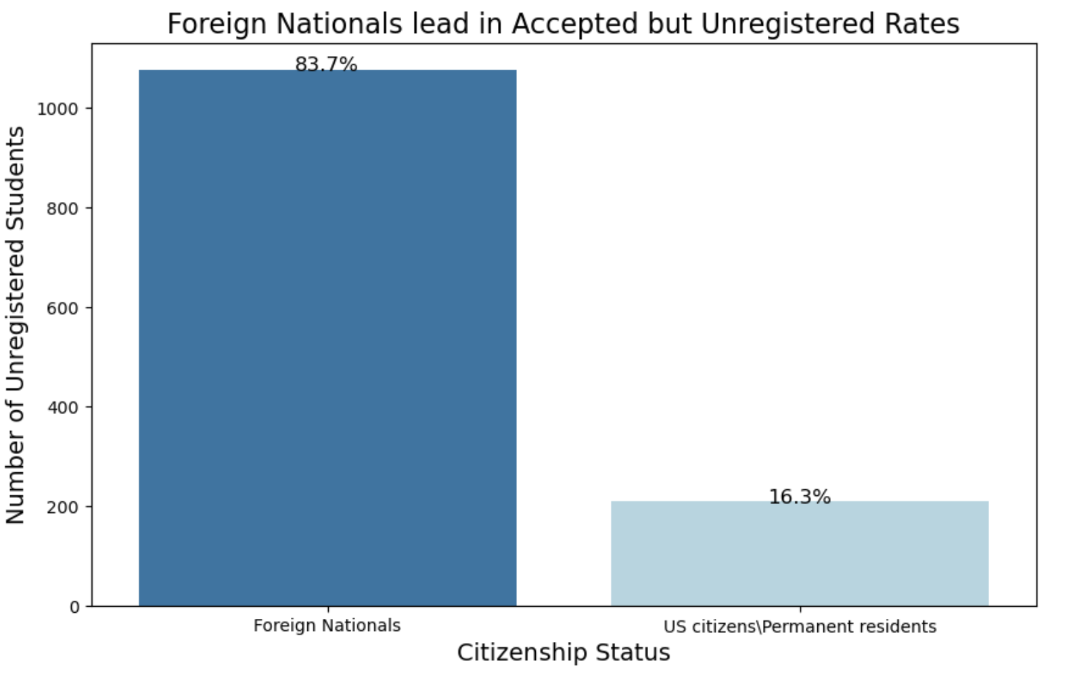
Confirm but Don't Register
BACK

Slide 33
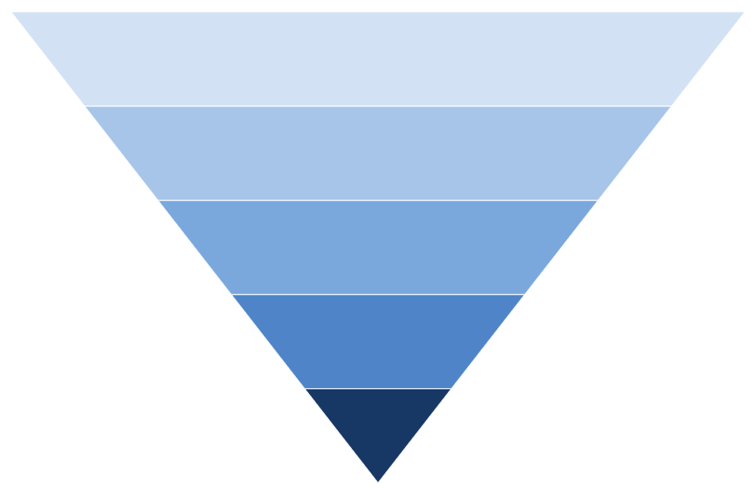
Inquiries: 26k records
Applied: 26k records
Admitted: 7k records
Confirmed: 4k records
Registered 2k records

Slide 34
